Slide 1
DEXPI hackathon Test Cases
V1.0 of Mar 14th, 2017
Reiner Meyer-Rössl
Global Business Development Process Plant

Slide 2
Changes to last version
One TODO directory instead subfolders below each case.
With submitting an export, an import to the verificator should also be done (maybe automatically)

Slide 3
How to colaborate between hackathons
Goals:
Enabling De-syncronized and scattered workflow
Track progress
Principles & Guidlines:
Common space
Naming convention
Workflows
Automated reporting

Slide 4
Test Cases
Exx Equipment
Pxx Pipelines, Inline Items, OPC
Ixx Instrumentation
Dxx Drawing annotation, title block
Cxx Complete small loops / Combination

Slide 5
Naming Conventions and Workflows
Directory structure on BSCW.avt.rwth-aachen.de
E01
test cases
E02
I01
…
TODO
<Ven B>
<Ven C>
<Ven A>
HINT:
During upload the file type must also entered in the name field.

Slide 6
Vendor abbreviations
Autodesk AUD
Aveva AVV
DEXPI DXI
Evonik EVO
Heiner Temmen Human Verificator HUV
Intergraph ING
Siemens SAG
Verificator VER
VTT VTT
X-Visual XVT
eVision EVI

Slide 7
Naming Conventions
Test case has version:
E02V01
After export from Vendor A, export also has version:
E02V01-VenA.EX01.jpg – screenshot of Test case
E02V01-VenA.EX01.xml – DEXPI file
After import from Vendor B (also with version):
E02V01-VenA.EX01-VenB.IM03.jpg – screenshot after import
E02V01-VenA.EX01-VenB.IM03.txt – descripton of problem or positive test result (like data that could be used)

Slide 8
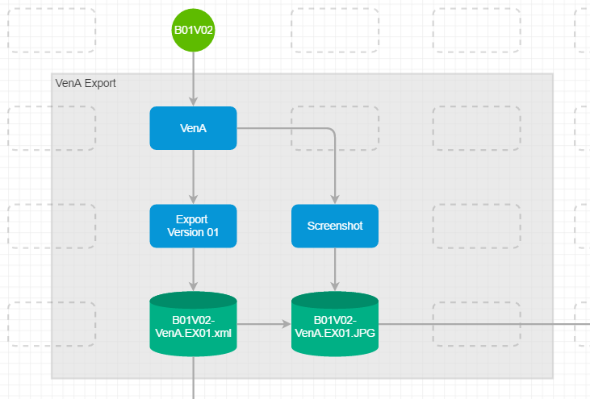
How to create an export TC: B01, TC Version: 02, Vendor: VenA, export version: 01
Create the sample drawing in exporting system
Make screenshot -> B01V02-VenA.EX01.JPG
Create XML file -> B01V02-VenA.EX01.XML

Slide 9
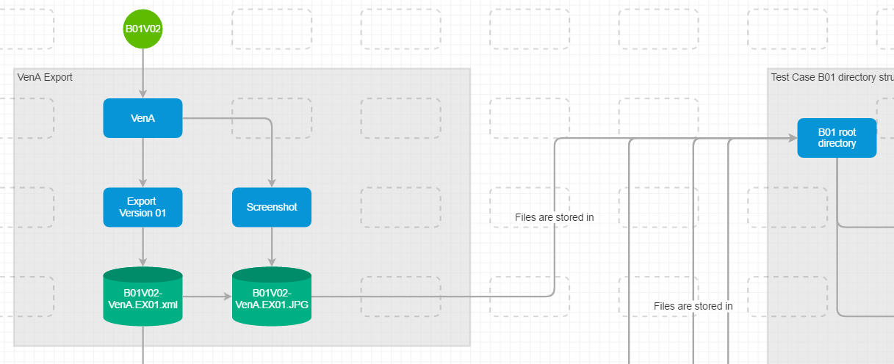
Where to store the files after the first export TC: B01
In the root folder of the Testcase

Slide 10
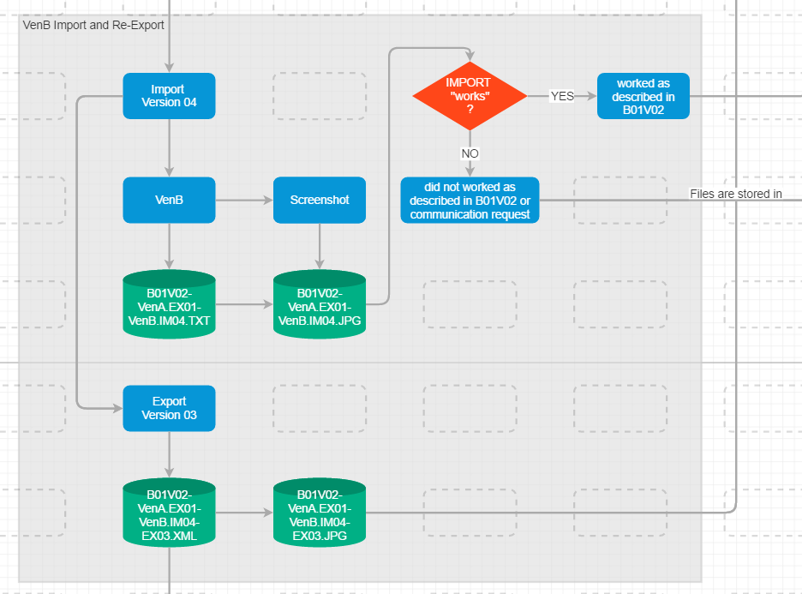
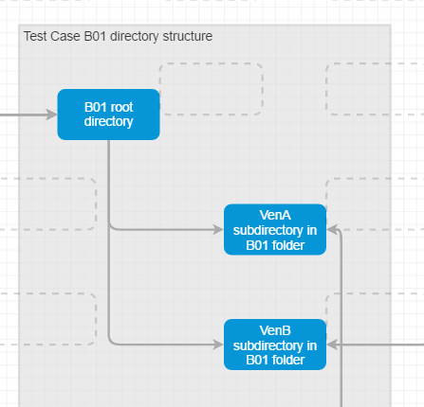
How to document an import TC: B01, TC Version: 02, Vendor: VenA, export version: 01

Slide 11
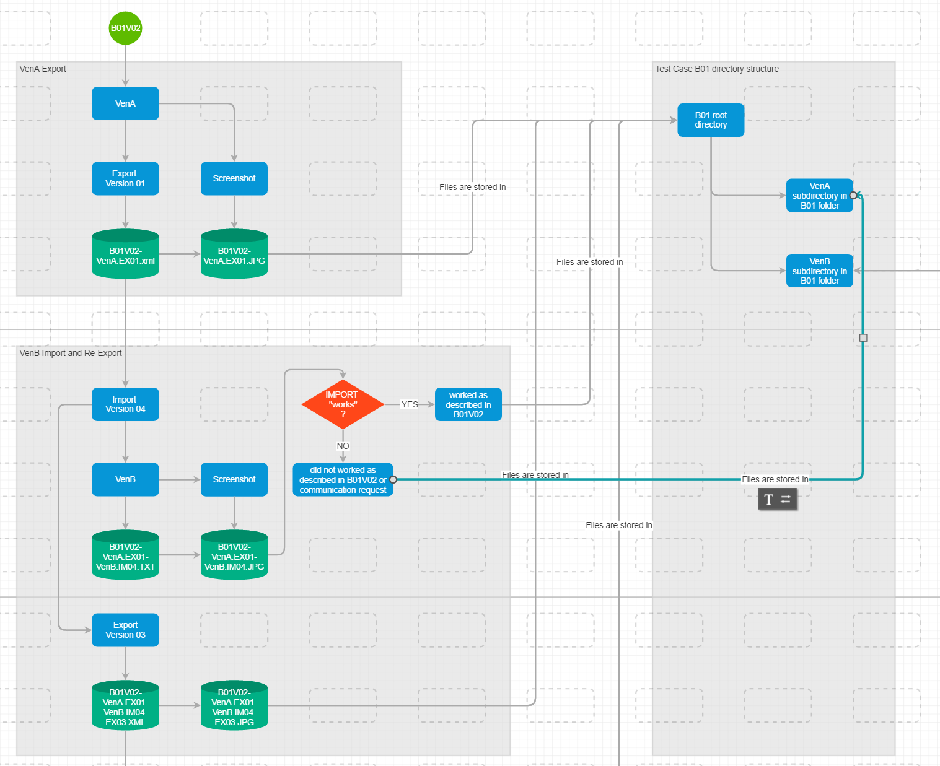

Slide 12
Currently we don‘t do the roundtrip, so the next slides are hidden.

Slide 13
Naming Conventions (con‘t) Only applicable for Vendors with EXP + IMP
Loop Back or third party:
E02V01-VenA.EX01-VenB.IM03-EX01-VenC.IM02.jpg/txt
E02V01-AUD.EX01-SAG.IM03-EX01-AUD.IM02.jpg/txt
Only applicable for Vendors with Export and Import

Slide 14
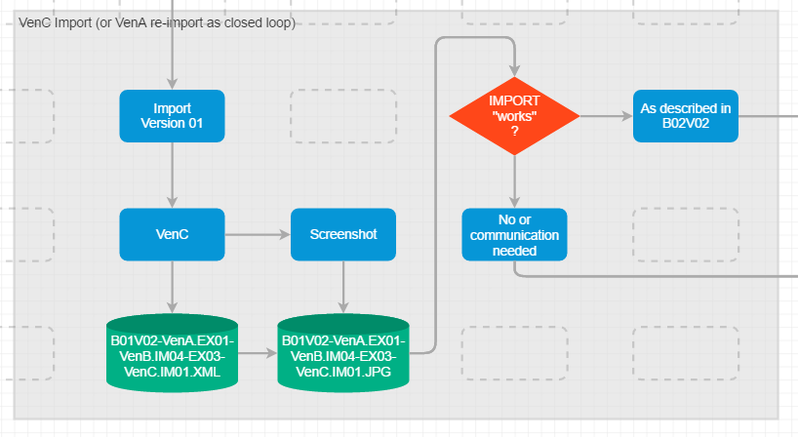

Slide 15
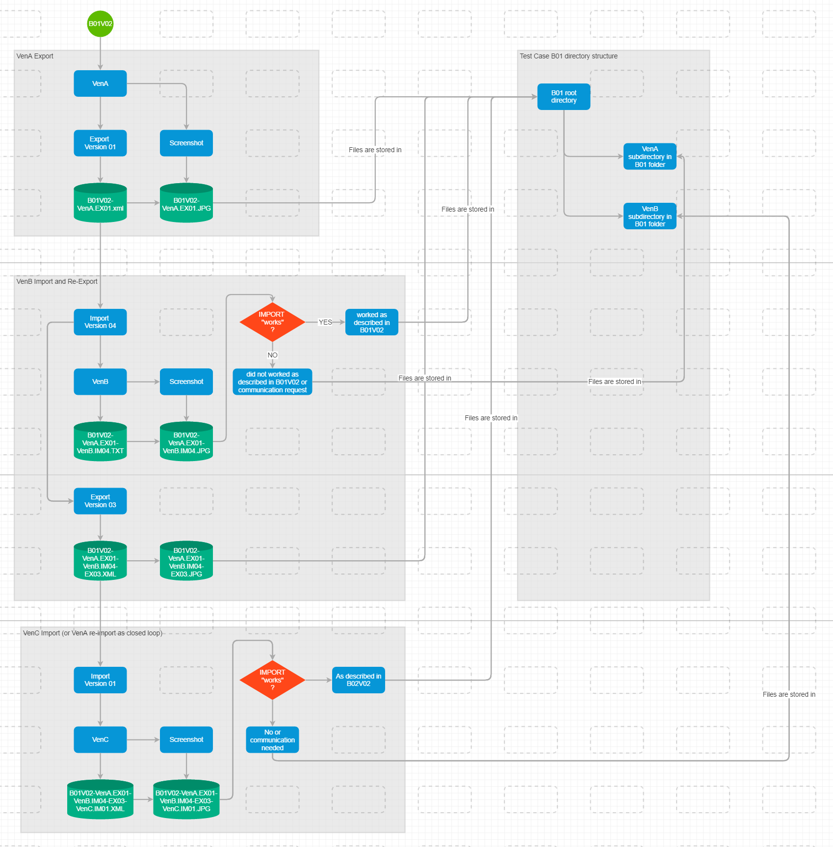

Slide 16
What has been achieved?
Progress is transparent
To-Do‘s are in vendors directory
Extentable Test cases (future proof)
Automatic report via scripts is possible

Slide 17
Submitting Test Case Procedure
Take the next free number
Describe Test Case in single page PPT, include a picture
Create a directory for the Test Case
Upload the PPT into the Test Case folder
TCCT creates the initial test cases, everybody can submit a new TC

